Slide 1
Assignment 3
Time and space complexity
Stack and Queue Manipulation
Static fields and methods
Data Structures, Fall 2018
TA: Marija Stanojevic

Slide 2
Time complexity
T(3n+5)=O(n) T(4n²+n*log(n))=O(n²) T(2n*log(n)+3n+4)=O(n*log(n))
Big-O complexity: remove all numbers and take just the biggest degree of n.
for (i = 0; i < N; i++) { for (i = 0; i < N; i++) { for (i = 0; i < N; i++) { for (j = 0; j < M; j++) { for (j = i+1; j < N; j++) { sequence of statements sequence of statements sequence of statements } } } for (j = 0; j < M; j++) { } // O(N * M) } // T(N * N) => O(N²) sequence of statements
} // O (N + M)
for (i = 0; i < 10; i++) { for (i = 0; i < N; i++) { x = n; // O(1)
for (j = 0; j < 10; j++) { for (j = 0; j < 10; j++) { for (int k: haystack) {
sequence of statements sequence of statements if (k == needle) { } } return true; } // O(1) } // T(N * 10) => O(N) } // O(N) size of haystack

Slide 3
Space complexity
int sum(int x, int y) { int sum(int a[], int n) { int multiply(int a[], int b[], int n) { int r = x + y - 20; int r = 0; int [][] c = new int[n][n];
} // O(1) for (int i = 0; i < n; i++) { for (int i = 0; i < n; i++) {
r += a[i]; for (int j = 0; j < n; j++){
} c[i][j] = a[i] * b[j];
} // O(n) }
}
} // O(n²)
Variables have O(1) space complexity.
Arrays/linked lists have O(n) space complexity.
Matrices have O(n²) or O(n*m) space complexity depending on the dimension
Time and space complexities can be different
If we want to multiply each element of list with all the other elements of the list, time complexity is O(n²) and space complexity is O(n).

Slide 4
Complexities of common tasks
O(1) Constant (fixed expressions, not depending on the input size)
O(log n) Binary Search
O(n) Sequential search; finding minimum/maximum; calculating average
O(n²) Selection Sort
O(n log n) Merge Sort, Quick Sort
O(n³) Matrix Multiplication
O(2^{n}) Recursions with two options

Slide 5
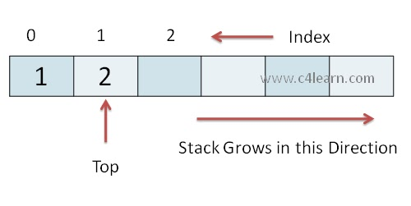
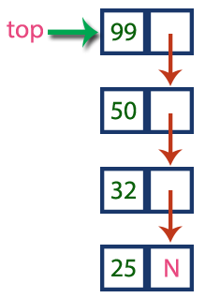
Stack
Last In First Out Structure (LIFO)
Maintains only one pointer to the top of the stack
Usual operations:
push (adds new element at the top of the stack)
pop (removes an element from the top of the stack)
peek (returns value at the top of the stack)
empty (is top of the stack null)
size (number of elements in the stack)
Can be implemented as array (java.util.Stack, java.util.ArrayDeque) or linked list (java.util.LinkedList)

Slide 6
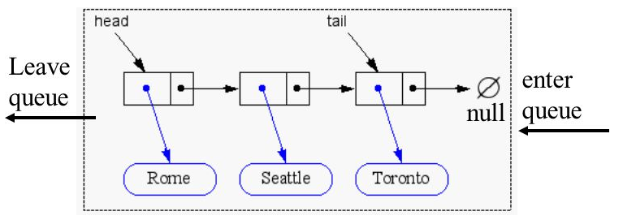
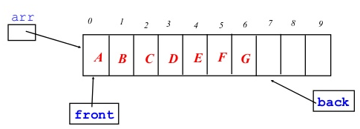
Queue
First In First Out (FIFO)
Maintains two pointers front/head and back/rear/tail
Usual operations:
offer (adds element to the end of the list), if full returns false
add (adds element to the end of the list), if full throws an error
poll (removes element from the end of the list), if empty returns false
remove (removes element from the beginning of the list), if empty throws an error
peek (shows value of the element at the beginning of the list)
empty (size is 0)
size (number of elements in the queue)
Can be implemented as array (java.util.PriorityDeque) or linked list (java.util.LinkedList)

Slide 7
Static fields and functions
public class ExampleClass {
private static LinkedList<String> exampleList = new LinkedList<String>();
public static void main(String [] args) {
int input = args[0];
switch (input) {
case 1:
addNewElement();
break;
case 2:
ExampleClass.removeElement();
break;
}
}
public static String addNewElement() { return “Example added”; }
public static String removeElement() { return “Example removed”;}

